Slide 1



Classic Vehicle Repair
Guided by :
Prof. Dhaval patel

Slide 2




Team Member
Vansh Godhani (21IT038)
Harsh Goyani (21IT042)
Jehil Kalkani (21IT056)

Slide 3



Abstarct
Classic Vehicle Repair is a management portal of car services. Customer Can Repair Own Vehicle Using This Web-Application. Customer Can Show The Status Of Vehicle Repairing. Customer Can Show The Total Cost Of Repairing And Also Generate The Invoice. This Portal Is Not For Globally.

Slide 4
Problem Statement
Customer Can’t Find Best Service Center.
Customer Can’t Show Live Vehicle Status.
Customer Can’t Save Own Expensive Time.

Slide 5
Scope of the System
Classic Vehicle Manage Is Easy To Manage Vehicle WorkShop. This System Is Based On Web-Application And Also Is Not For Globally.
This Web-Application Is Use For Some Particular Garage Or Service Centers.
Modules:
Customer
Admin
Mechanic

Slide 6
Main Flow Of Classic Vehicle repair
Classic Vehicle repair
7

Slide 7




admin
Request For Repair Vehicle
Assign The Mechanic For Customer Vehicle
Registration , login
Check Invoice details or Repaired Vehicles
Invoice
Update Status For Customer Vehicle
Customer
Mechanic

Slide 8
Customer Functionality
Customer Will Signup And Login Into System
Customer Can Make Request For Service Of Their Vehicle By Providing Details (Vehicle Number, Model, Problem Description etc.)
After Request Approved By Admin, Customer Can Check Cost, Status Of Service
Customer Can Delete Request (Enquiry) If Customer Change Their Mind Or Not Approved By Admin (ONLY PENDING REQUEST CAN BE DELETED )
Customer Can Check Status Of Request(Enquiry) That Is Pending, Approved, Repairing, Repairing Done, Released

Slide 9
Mechanic Functionality
Mechanic Will Apply For Job By Providing Details Like (Skills, Address, Mobile etc.)
Admin Will Hire(Approve) Mechanic Account Based On Skill.
Mechanic Can See How Many Work (Vehicles To Repair) Is Assigned To Me.
Mechanic Can Change Status Of Service ('Repairing', 'Repairing Done’) According To Work Progress
Mechanic Can See Salary And How Many Vehicles He/She Have Repaired So Far.

Slide 10
Admin Functionality
After login , admin can see how many customer, mechanic, recent service orders on dashboard
Admin can see each customer invoice (if two request made by same customer it will show total sum of both request)
Admin can approve(hire) mechanics (requested by mechanic) based on their skills
Admin can see/update/delete request/enquiry for service sent by customer
Admin can also make request for service (suppose customer directly reached to service center/office)
Admin can approve request for service made by customer and assign to mechanic for repairing and will provide cost according to problem description
Admin can see all service cost of request (both approved and pending)

Slide 11
Other Features
we can change theme of website day(white) and night(black)
if customer is deleted by admin then their request(Enquiry) will be deleted automatically.

Slide 12
Future Enhancement
Customer Can’t Show The Amount Is Paid Or Not.
We Provide Live Status Of Customer Vehicle .
We Provide Online Payment Option For Customer.
We Provide Revoke Entry After Admin Approved.
We Provide Pick-Up And Drop Facility For Customer Vehicles.

Slide 13
Hardware And Software Specifications
HARD-WARE SPECIFICATION
Processor : Intel Core i5
RAM : Minimum 4 GB
Storage : 500 GB
SOFT-WARE SPECIFICATION
Visual Studio Code
Google Chrome , Microsoft Edge(any Browser)
PyCharm , python , Django

Slide 14
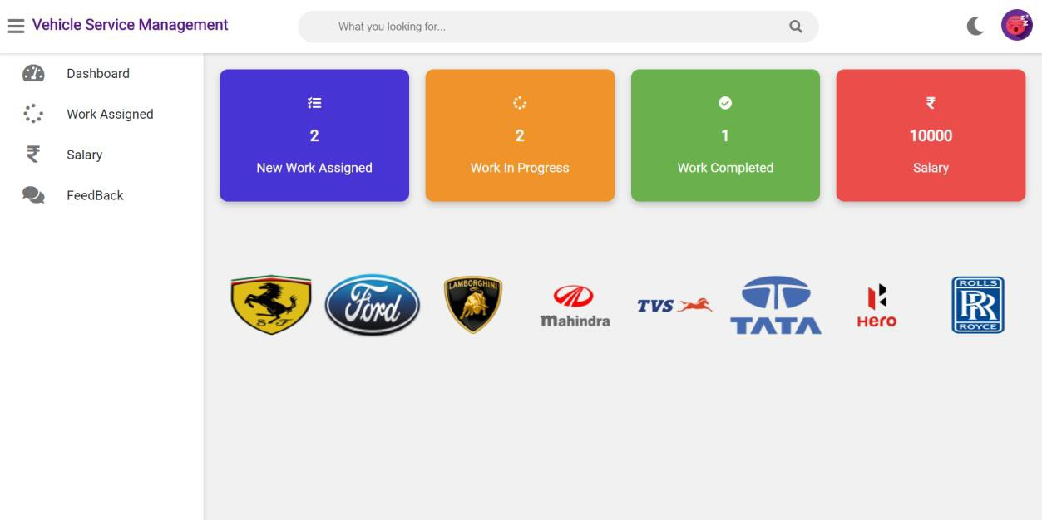

Slide 15
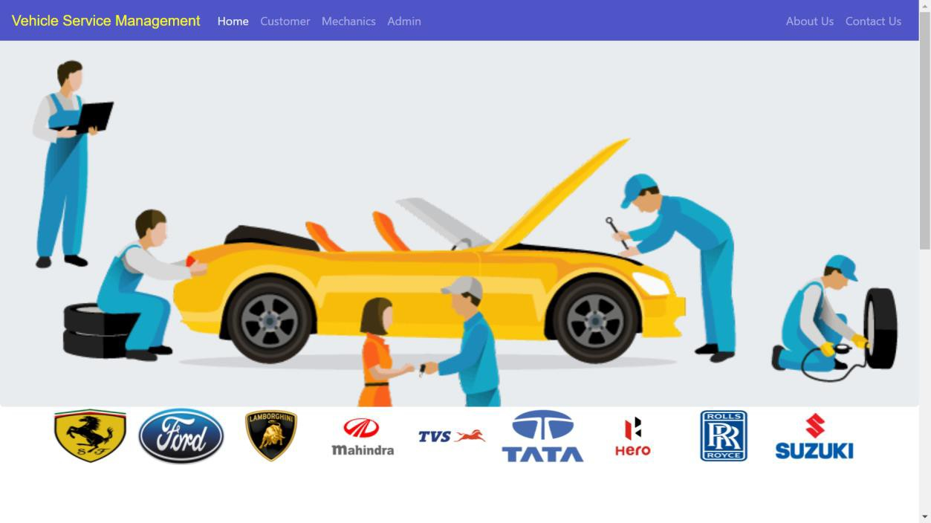

Slide 16
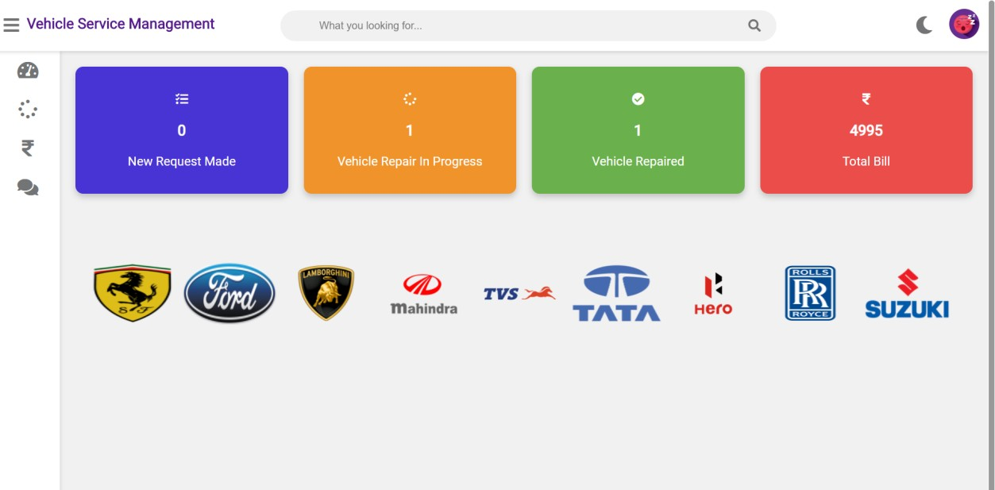

Slide 17
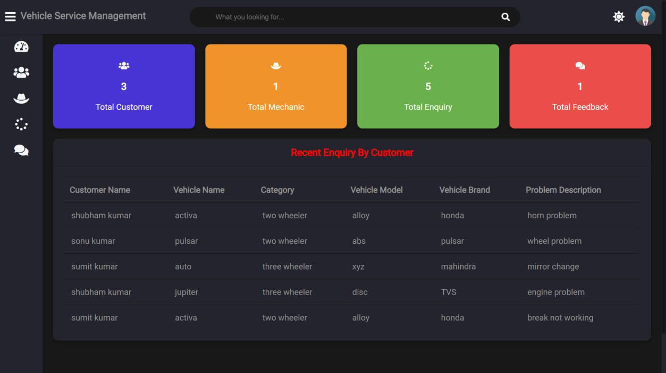

Slide 18
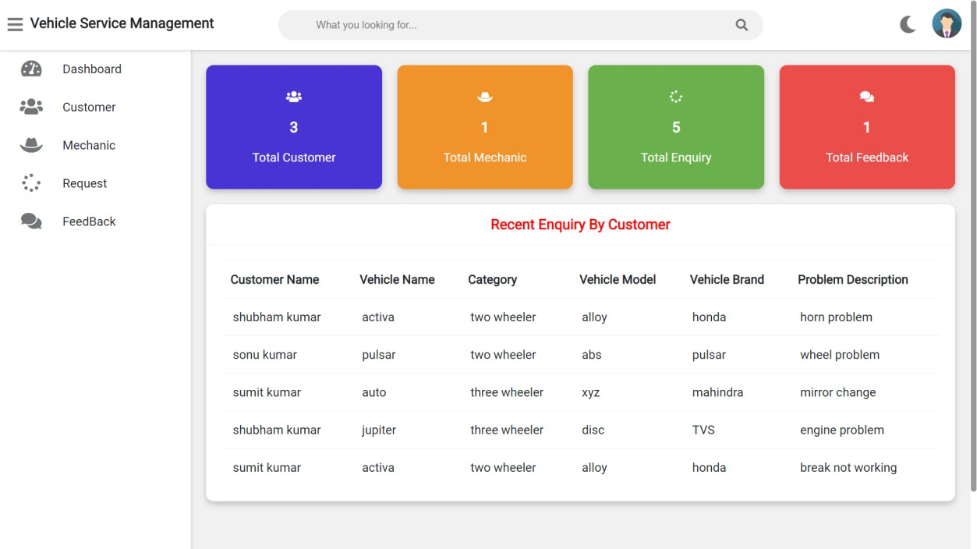

Slide 19

Thank you
Thank You For Giving Your Time .

